Slide 1
Academic Search Engine
A mini Project by : 1) Sanchit Khemnar - 112103071
2) Atharv Mahajan - 112103081

Slide 2
CONTENTS
INTRODUCTION
PURPOSE
USER INTERFACE
IMPLEMENTATION
MAJOR RESOURCES
CONCLUSION

Slide 3
INTRODUCTION
This project is concerned with developing student record management system.
It makes student’s data management more accessible to the students and admin.
This project have the ability to display the details of students in college such as MIS no. , branch , division , batch , college mail id , mobile no.
This project also has ability to make changes in the available dataset.

Slide 4
PURPOSE
To provide “better and efficient” service to students.
To provide more accessible way to the data management system for students and admin.
To give fast output of information about desied student.
To provide data security.

Slide 5
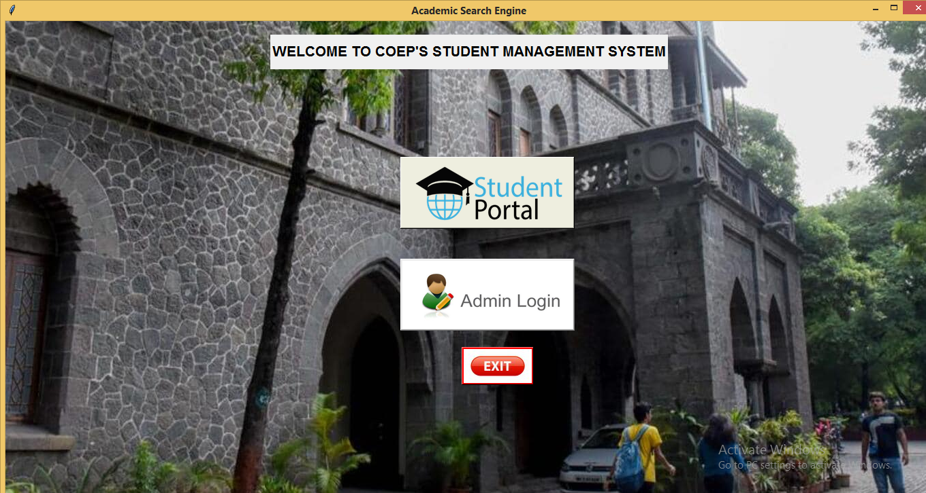
USER INTERFACE

Slide 6
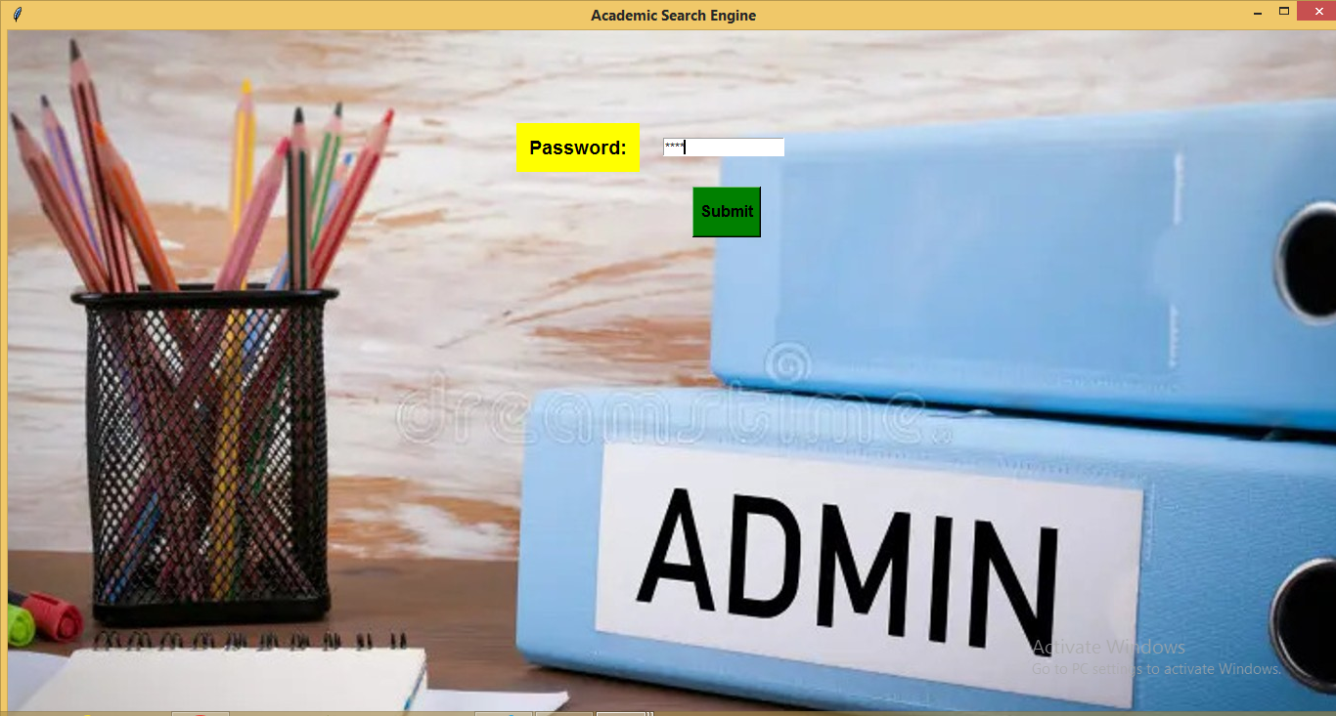
LOGIN PAGE (Admin Portal)

Slide 7
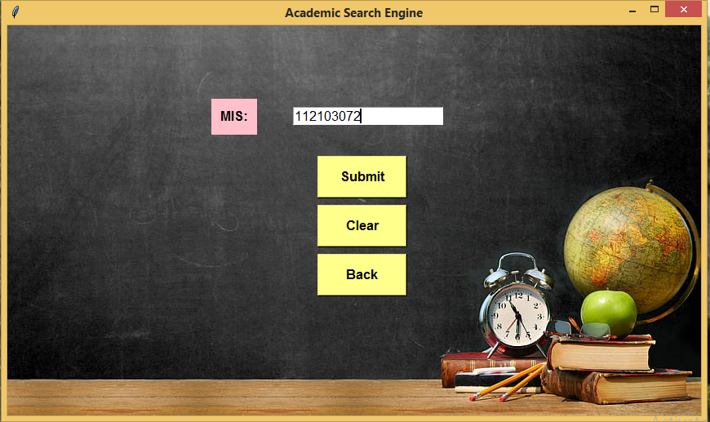
IMPLEMENTATION STUDENT PORTAL

Slide 8
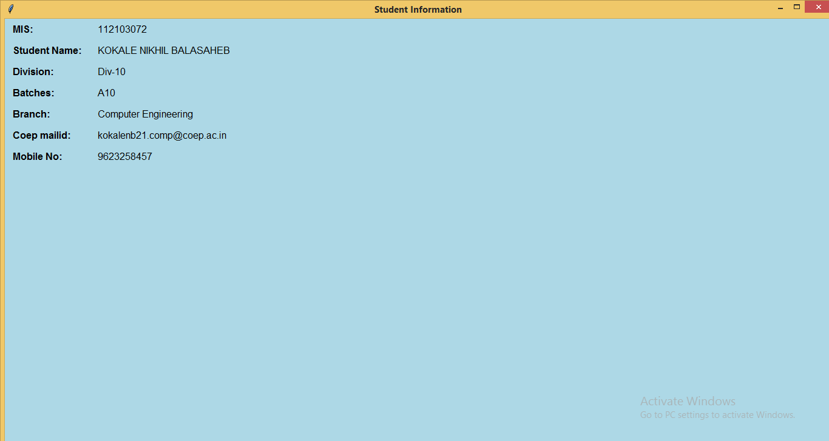

Slide 9
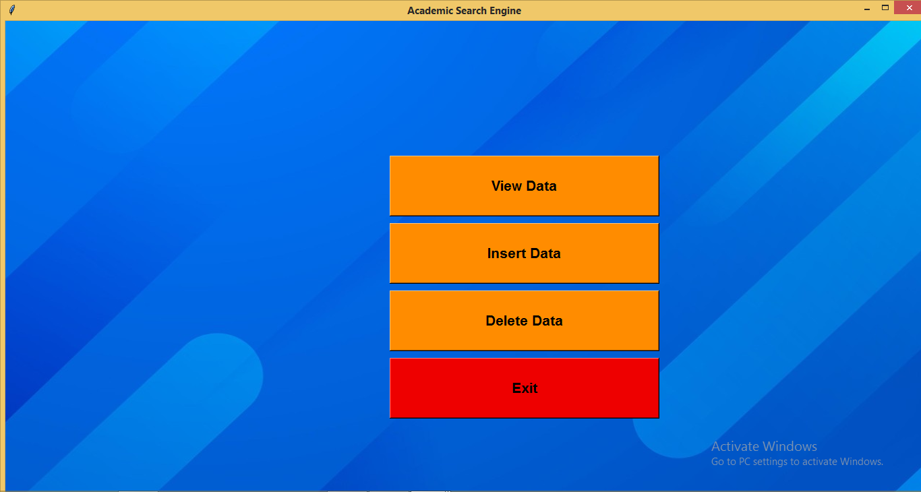
ADMIN PORTAL

Slide 10
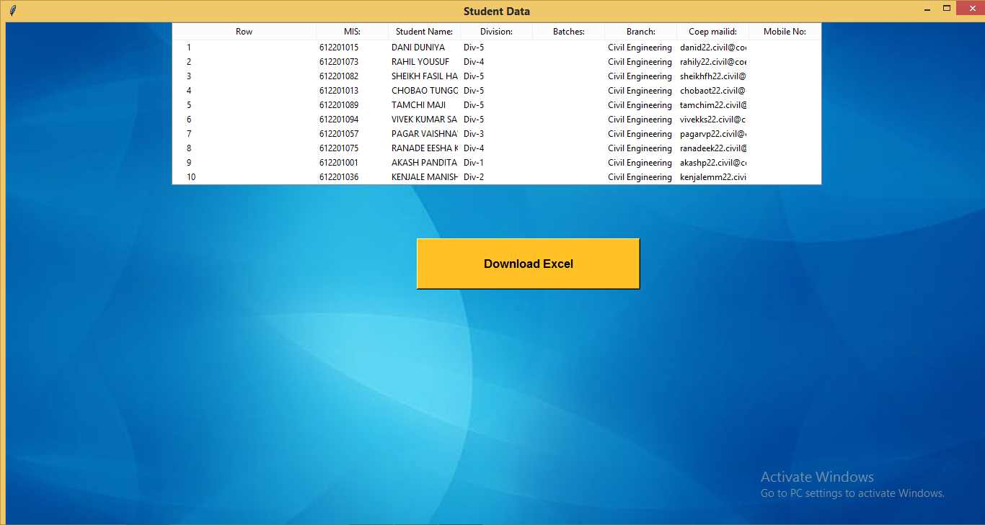
VIEW DATA

Slide 11
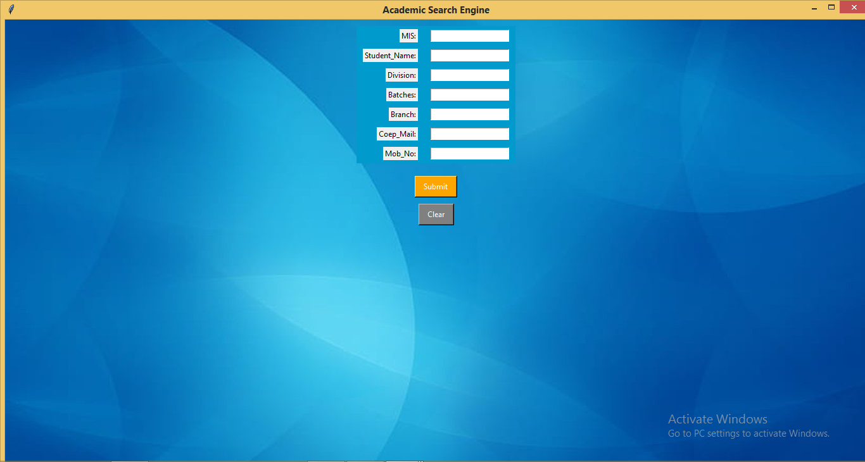
INSERT DATA

Slide 12
MAJOR RESOURCES
PYTHON libraries such as Pandas , Tkinter , Pillow.
MYsql as database connector.

Slide 13


